Slide 1
Gene-gene interactions in psychiatric diseases
An introduction to initial analysis of my PhD
Jolien Rietkerk, Msc
Joint project of Helmholtz Zentrum Muenchen, Pioneer Campus, translational genetics – Max-Planck Institut, statistical genetics
December 2020

Slide 2
What makes depression a complex phenotype to study?
Minimum 5 out of 9 symptoms
Must include one (or both) of the orange ones.
105 total combinations that all lead to the depression diagnosis
Reliable on selfreport/self judgement, system report and clinical judgement
Overlap of symptoms with other psychiatric diseases such as schizophrenia
Depresision
Depressed mood
Loss of interest or pleasure
Impaired ability to think, concentrate, or make decisions
Recurrent thoughts of death
Significant unintentional wieghtloss/gain or decrease/increase appetite
Sleep disturbance
Psuchomotor changes
Tiredness, fatigue, or low energy, decreased efficiency
A sense of worthlessness or excessive, inappropriate, or delusional guilt
Notes:
Many cases, very little is understood
GWAS hits starting to pop up as databases grow, but pheontyping remains heterogeneous.
To identify subtypes of depression, GWAS on different depression phenotypes were done, most of which were minimal phenotypes: self-reports, questionaires and ‘‘using antidepressants‘‘ from a health record.
A colleague of mine is currently working on GWAS of individual depression symptoms.
2 options orange
4 out of 7 gives 35 combinations possible.
2*35 combinations is 70 total possibliities…
But it is also possible to have both of the orange ones So that adds 3 out of 7 gives another 35 combinations possible. So

Slide 3
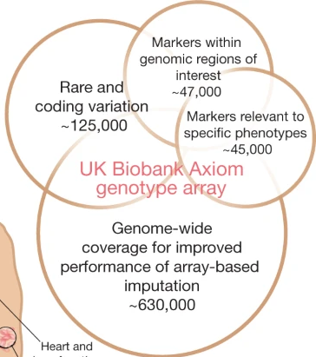
What makes the human genotype to study?
Many SNPs
Linkage disequilibrium / gamete phase disequilibrium
Many confounds!
Population structure
Environment
Notes:
Biobank!

Slide 4
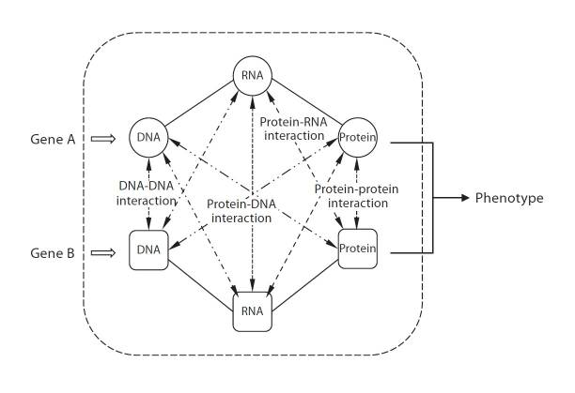
What are gene-gene interactions?
Why gene-gene interactions?
Notes:
Wang2010

Slide 5
Methods to study genotype to phenotype relationship
GWAS
Gene-gene interactions
Gene-environment interactions
Linkage studies
etc

Slide 6
Main hypotheses
Coordinated Interaction is part of the molecular etiology of Major Depressive Disorder
Specific pathways are interacting as part of this etiology
Prioritized genes within these pathways are of particular interest to drug design and personalized medicine approaches

Slide 7
Main hypotheses
Coordinated Interaction is part of the molecular etiology of Major Depressive Disorder
Specific pathways are interacting as part of this etiology
Prioritized genes within these pathways are of particular interest to drug design and personalized medicine approaches

Slide 8
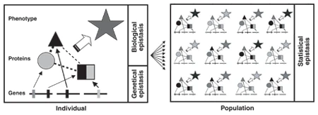
What are gene-gene interactions?
Statistical definition
Biological definition
Different types of epistasis: x x x
Coordinated Interaction
Notes:
Moore 2005

Slide 9
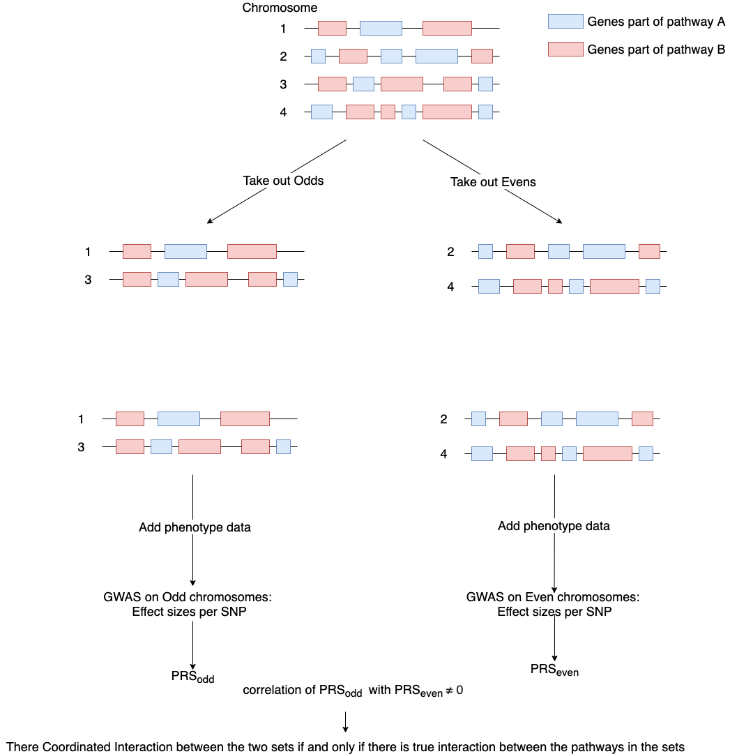
Coordinated Interaction

Slide 10
Coordinated Interaction

Slide 11
Page 5 CI paper: even odd estimator formula add here ☺
Add figure 1 CI paper as well
Many traits have significant epistasis, method works very well if you assume the phenotype has causal snps evenly spread across theg enome and the pathways are also evenly spread across the genome, so for depression, this is likely to work because we know of its many genes involved.

Slide 12
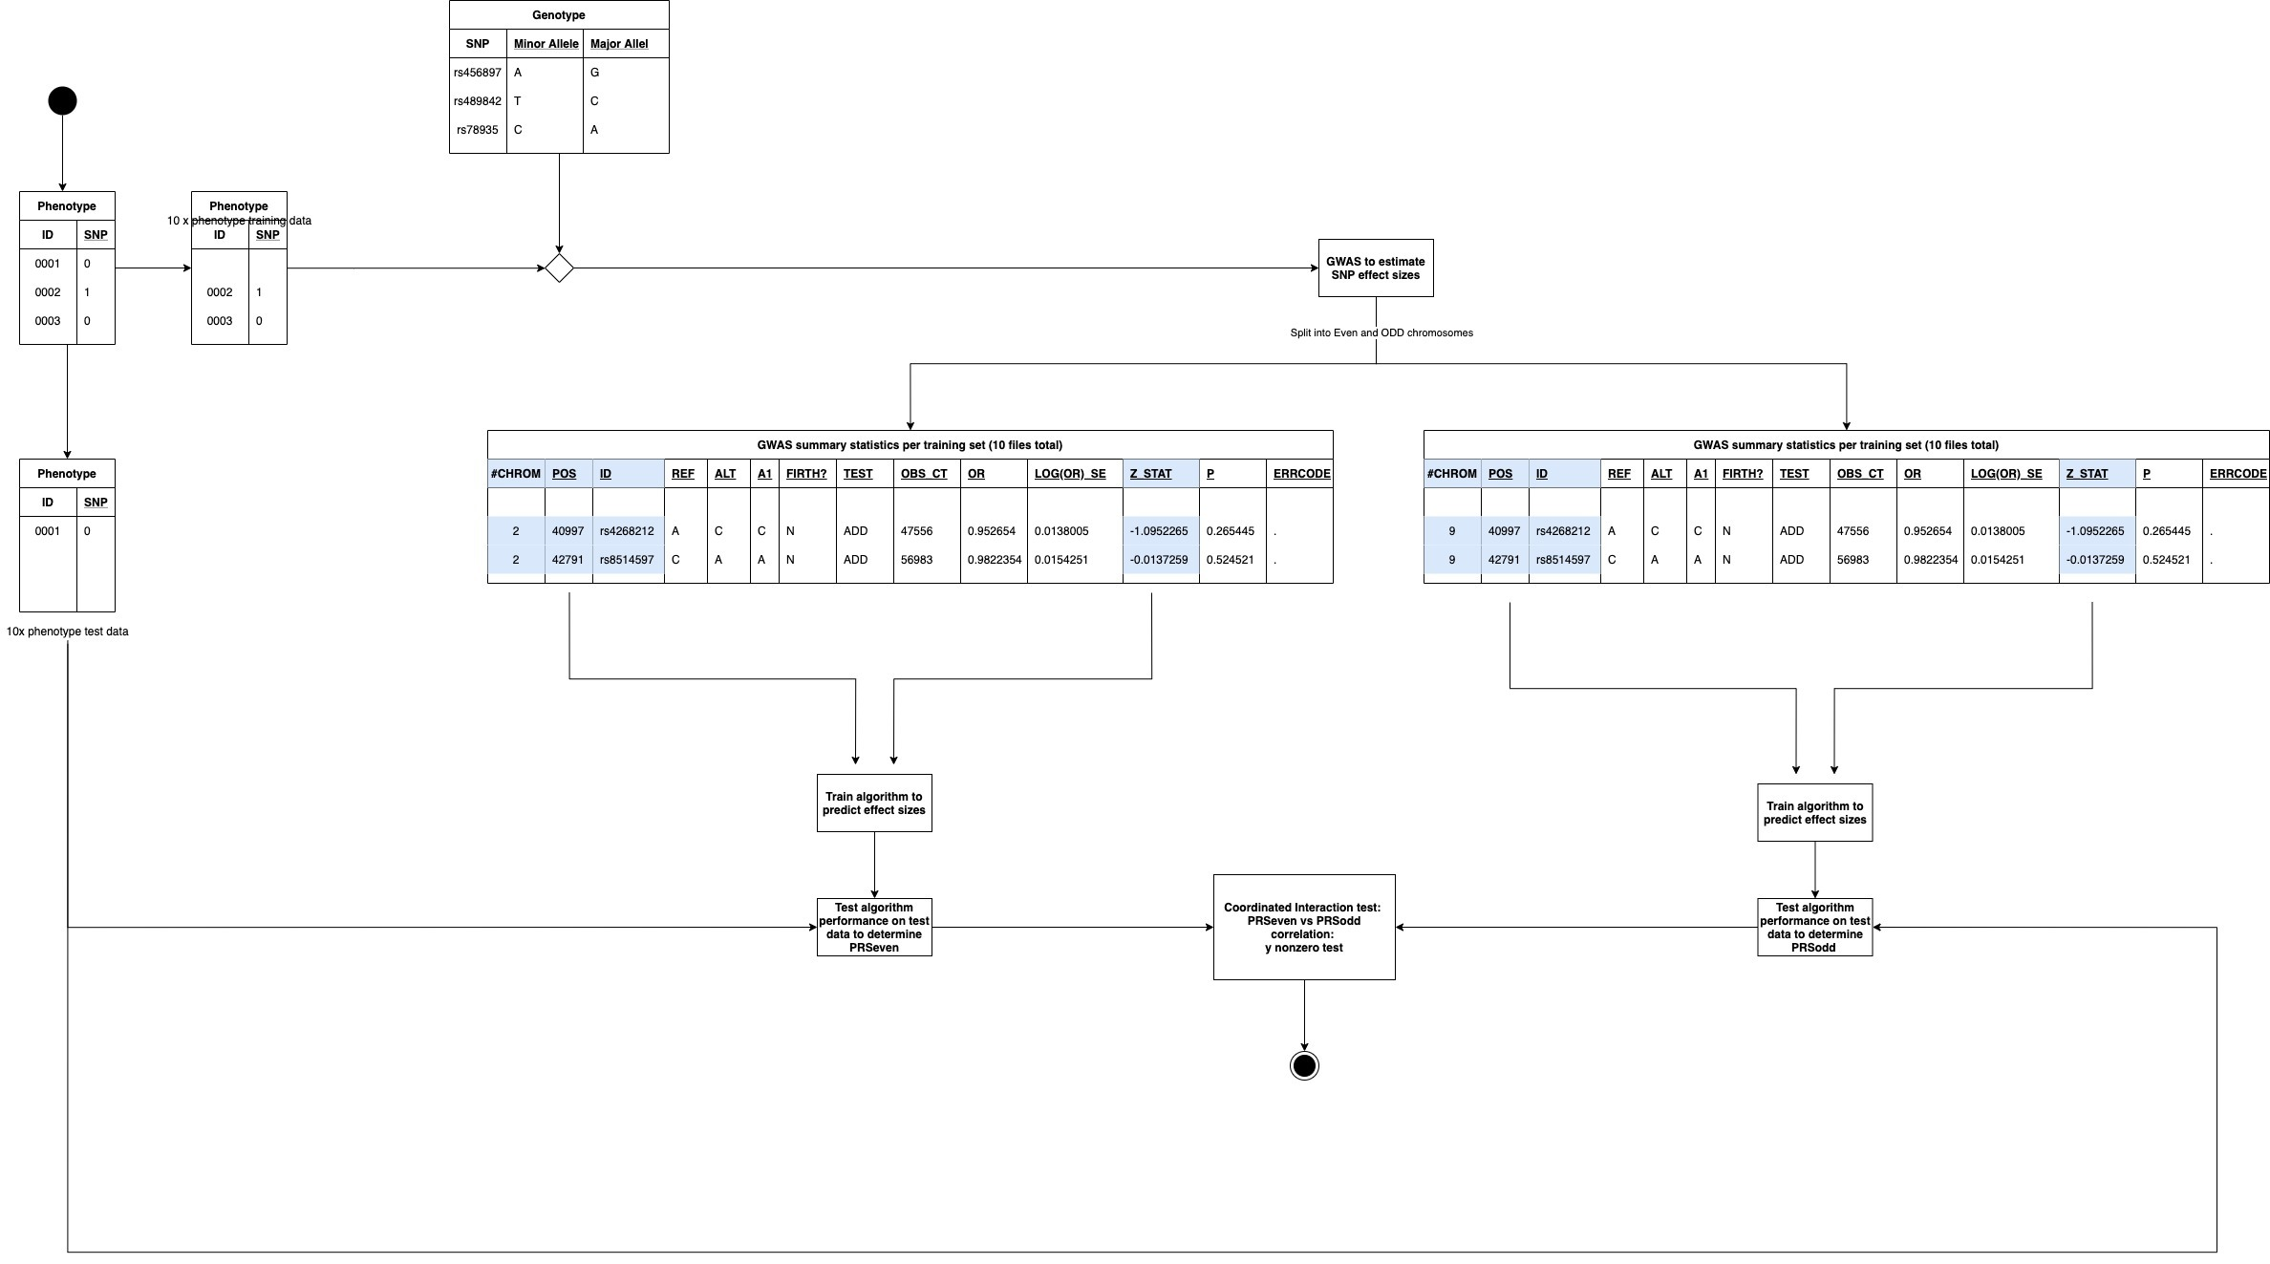
Coordinated Interaction Workflow

Slide 13
Main hypotheses
Coordinated Interaction is part of the molecular etiology of Major Depressive Disorder
Specific pathways are interacting as part of this etiology
Prioritized genes within these pathways are of particular interest to drug design and personalized medicine approaches
Notes:
Many cases, very little is understood
GWAS hits starting to pop up as databases grow, but pheontyping remains heterogeneous.
To identify subtypes of depression, GWAS on different depression phenotypes were done, most of which were minimal phenotypes: self-reports, questionaires and ‘‘using antidepressants‘‘ from a health record.
A colleague of mine is currently working on GWAS of individual depression symptoms.
2 options orange
4 out of 7 gives 35 combinations possible.
2*35 combinations is 70 total possibliities…
But it is also possible to have both of the orange ones So that adds 3 out of 7 gives another 35 combinations possible. So

Slide 14
Thank you
Notes:
Many cases, very little is understood
GWAS hits starting to pop up as databases grow, but pheontyping remains heterogeneous.
To identify subtypes of depression, GWAS on different depression phenotypes were done, most of which were minimal phenotypes: self-reports, questionaires and ‘‘using antidepressants‘‘ from a health record.
A colleague of mine is currently working on GWAS of individual depression symptoms.
2 options orange
4 out of 7 gives 35 combinations possible.
2*35 combinations is 70 total possibliities…
But it is also possible to have both of the orange ones So that adds 3 out of 7 gives another 35 combinations possible. So

Slide 15
Psychiatric disease: depression
DSM-V symptoms:
5 or more of the following A criteria (at least one includes A1 or A2)
A1 Depressed mood – indicated by subjective report or observtaion by others (in children and adolescents, can be irritable mood
A2 Loss of interest or pleasure in almost all activities – indicated by subjective report or observation by others
A3 significant (more than 5 percent a month) unintentional weight loss/gain or decrease / increase in appetite (in children, failure to make expected weight gains).
A4 Sleep disturbance (insomnia or hypersomnia)
A5 Psychomotor changes (agitation or retardation) severe enough to be observable by others
A6 Tiredness, fatigue, or low energy, or decreased efficiency with which routine tasks are completed
A7 A sense of worthlessness or excessive, inappropriate, or delusional guilt (not merely self-reproach or guilt about being sick).
A8 Impaired ability to think, concentrate, or make decisions – indicated by subjective report or observationi by others
A9 Recurrent thoughts of death (not just fear of dying), suicidal ideatio, or suicide attempts
The symptoms cause clinically significant distress or impairment in social, occupational, or other important areas of functioning
The symptoms are not due to the direct physiological effects of a substance (e.g., drug abuse, a prescribed medication’s side effects) or a medical condition (e.g., hypothyroidism)
There has never been a manic episode or hypomanic episode
MDE is not better explained by schizophrenia spectrum or other psychotic disorders
The symptom must either be new or must have clearly worsened compared with the person’s pre-episode status and must persist most of the day, daily, for at least 2 weeks in a row. Exclude symptoms that are clearly due to a general medical condition, mood-incongruent delusions, or mood-incongruent hallucinations.
Symptom must persist most of the day, daily, for at least 2 weeks in a row, excluding A3 and A9.
Notes:
Many cases, very little is understood
GWAS hits starting to pop up as databases grow, but pheontyping remains heterogeneous.
To identify subtypes of depression, GWAS on different depression phenotypes were done, most of which were minimal phenotypes: self-reports, questionaires and ‘‘using antidepressants‘‘ from a health record.
A colleague of mine is currently working on GWAS of individual depression symptoms.

